Slide 1
Iteration 0: What you must do first to set up an MVC 5 project for success
Jeffrey Palermo
Clear Measure, Inc.

Slide 2
Watch Recording of Session
https://www.youtube.com/watch?v=js7XKIhnGxQ
Code: https://github.com/ClearMeasure/IterationZero

Slide 3



Welcome to Houston TechFest
Thank you for being a part of the 8th Annual Houston TechFest!
Please turn off all electronic devices or set them to vibrate.
If you must take a phone call, please do so in the lobby so as not to disturb others.
Thanks to our Diamond Sponsors:

Slide 4
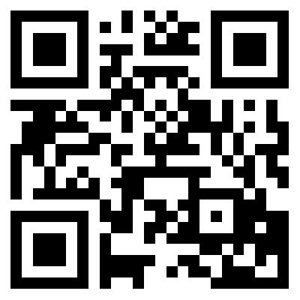
Please Leave Feedback During Q&A
If you leave session feedback and provide contact information in the survey, you will be qualified for a prize
Scan the QR Code to the right or go to http://bit.ly/1p13f3n
#htechfest
@jeffreypalermo

Slide 5



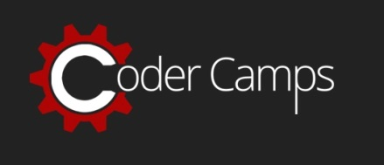

















Thanks to all our Sponsors!

Slide 6

Iteration Zero for ASP.NET MVC 5
Jeffrey Palermo
Managing Partner & CEO, Clear Measure
@jeffreypalermo
jeffrey@clear-measure.com

Slide 7
Agenda
What this talk is / what it is not
About myself (who cares, get with the goods!)
What the web stack looks like
Why configuration management matters (worldview)
Getting started with MVC 5
Web application source control
ASP.NET MVC Visual Studio solution structure
Web application automated build & continuous integration

Slide 8


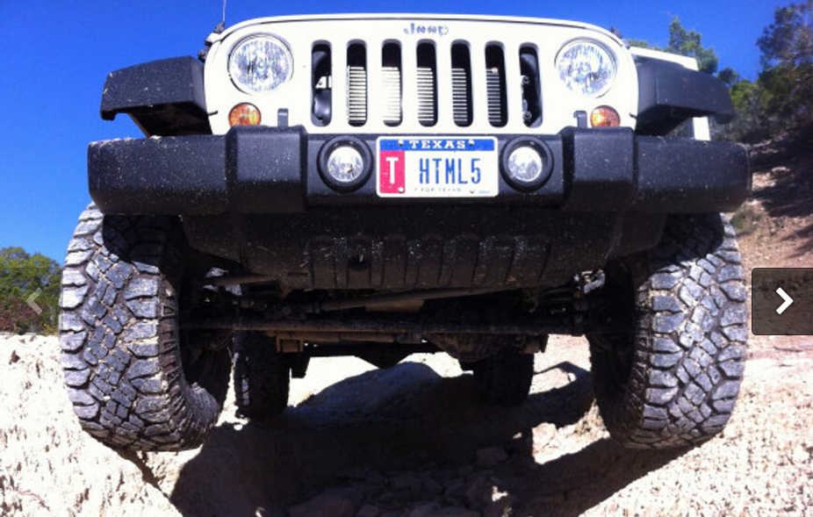
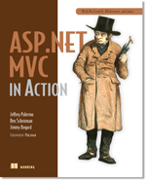

Who is this Jeffrey Palermo guy?
Personal
Father of three
Iraq veteran 2003-2004
Eagle Scout
Christian
Jeep off-roader
Professional
Programming for IIS since 1997
Written some articles, books, & blogs
Speaker at local conferences, MS Tech Ed, VS Live, DevTeach, etc
Ran Austin .Net User Group from 2005-2011
Microsoft MVP
http://www.safaribooksonline.com/library/view/aspnet-mvc-5/9780133892888/ google “safari online mvc 5 Palermo”
We are hiring!

Slide 9
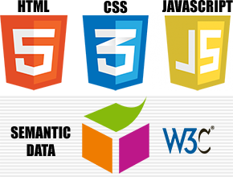

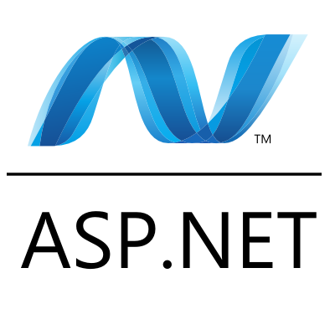
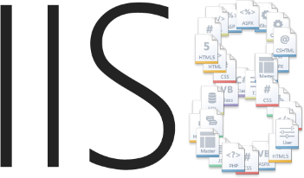
Web Stack

Slide 10
Why Iteration Zero Matters

Slide 11
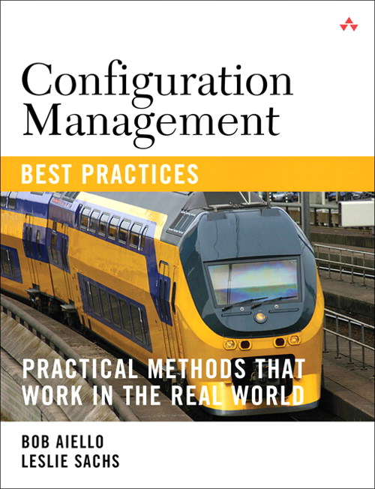
What is SCM?
What is Software Configuration Management
Source code management
Build engineering
Environment configuration
Change control
Release engineering
Deployment

Slide 12
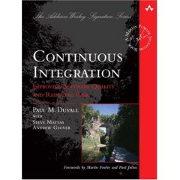
What is continuous integration?
It is the process of integrating small changes into the larger software system “early & often”
Creates frequent feedback in order to reduce the risks involved with changing your software system.
Reduces Risk by turning a large task into small bit sized chunks.

Slide 13
The Problem/Solution
“In my early days in the software industry, one of the most awkward and tense moments of a software project was integration. Modules that worked individually were put together and the whole usually failed in ways that were infuriatingly difficult to find. Yet in the last few years, integration has largely vanished as a source of pain for projects, diminishing to a nonevent.” – Martin Fowler, Foreword to Continuous Integration

Slide 14




Iteration Zero Goal (no features)
Developer
Developer
Source code management
Developer
Build engineering/ Environment configuration
Working
Software
Feedback

Slide 15
What to set up right away
Step 1 VCS
Source control structure
Gather dependencies
Step 2 Build
Compile
Step 3 Test
Deploy
Basic testing
Test
Package

Slide 16
Version Control System (VCS)
Also called Source Code Control (SCC)

Slide 17
Version control shapes your world-view
Locking
Non-Locking
Code is dangerous/risky to change
If someone is looking at a file, we need to keep others out
We need to be careful and intentional to keep the software stable
Code is safe/easy to change
It’s ok if multiple people change the same code file at the same time.
Sophisticated process and tools enable guaranteed recovery from any instability

Slide 18
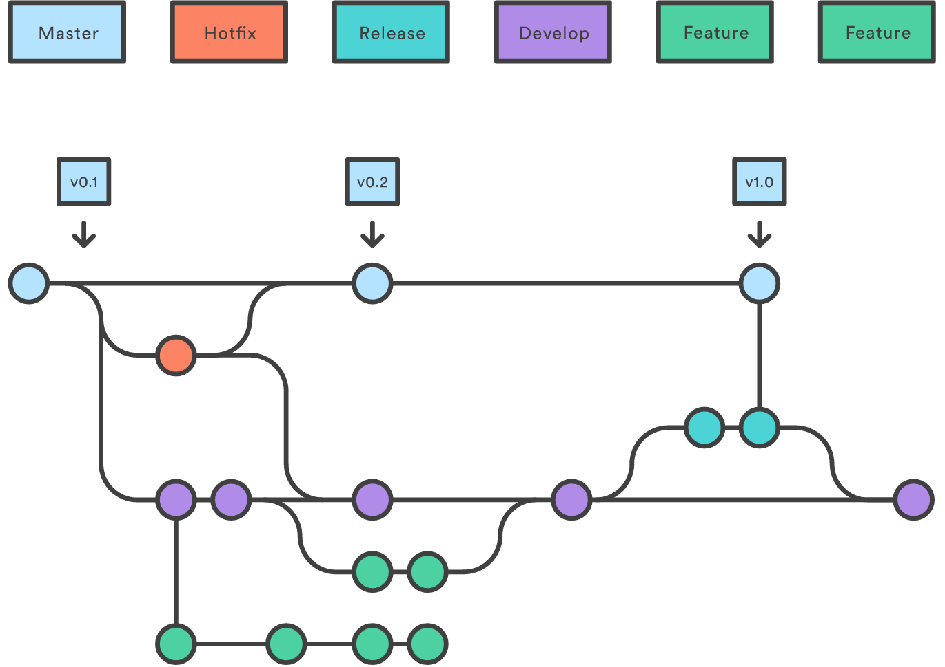
Git Flow https://www.atlassian.com/git/tutorials/comparing-workflows

Slide 19
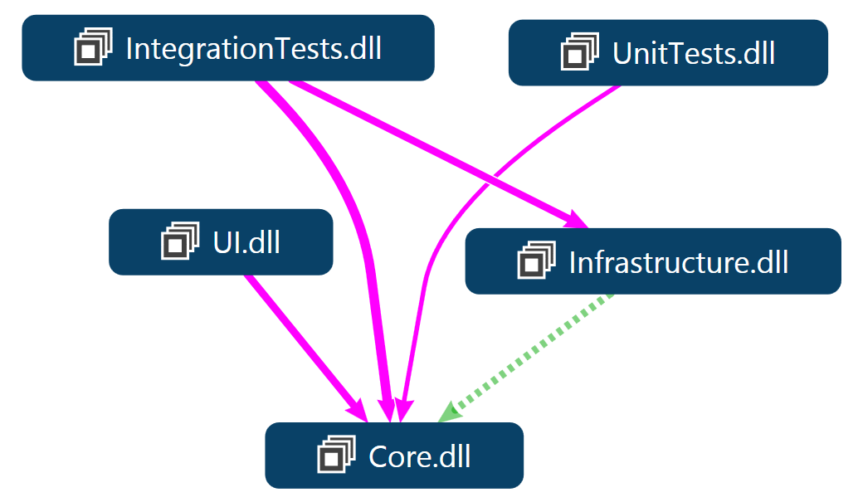
ASP.NET MVC Solution Structure Onion Architecture pattern

Slide 20
VCS & VS Solution Setup w/ Onion Architecture (DEMO)
Temporarily ignoring application layers

Slide 21
Build the software
Anyone heard of continuous integration?

Slide 22
Build engineering
Private Build – used by each developer to build and test their changes before they commit code to version control.
Integration Build – verifies each developers change against the entire systems. This ensures that the code in source control contains a working system.

Slide 23
Environment configuration
All configuration for the target environment should be done or simulated before each automated build.
Examples:
Database connection strings
Application config settings
Environment variables
Operating System settings
Web server settings

Slide 24
Demo agenda
Private build
Environment configuration(database)
Unit tests
Release packaging
Version, zip
Hook for Continuous Integration server (JetBrains TeamCity)
LET’S GO

Slide 25
Team Workflow
Iteration Zero’s goal is to set team up for productivity
Workshop
Fix a bug
Test-drive the fix
Database enhancement
UI fix
Integrate through Git-Flow process
Successful check-in dance
LET’S GO

Slide 26
Evolution in Software Configuration Management

Slide 27

Ask questions!
@jeffreypalermo
Jeffrey@clear-measure.com
512-298-2377
JeffreyPalermo.com

